Slide 1
“Mutation Operator based Image Encryption Algorithm for Securing IoT”
A Dissertation Work
Submitted in the partial fulfillment for the award of
Master of Technology in CSE
Submitted to
RAJIV GANDHI PROUDYOGIKI VISHWAVIDYALA,
BHOPAL (M.P.)
Submitted by : Rashmi Rajput
Enroll. No.: 0936CS18MT03
Under the supervision of
Prof. Sandeep Kumar Tiwari
Assistant Professor Dept. of CSE
Vikrant Institute Of Technology And Management, Gwalior(M.P.)

Slide 2
Table Of Contents:
Abstract
Introduction & Related Work
Proposed Method
Experimental Results
Conclusion and Future work
References
Publication

Slide 3
Abstract
In the current scenario, most of the communications via IoT enabled devices such as smart phones etc., are in the form of images and these devices are having less memory and require high-speed communications.
For such types of communications, there is a need for a secure encryption technique. This work proposed a mutation operator based image encryption algorithm.
This work uses 64-bits block cipher and 80 –bit key for encryption. Here mutation operator is used to creating confusion and diffusion among attackers.
This work generates a unique random key for each image encryption. The proposed work is implemented on MATLAB 2015 software and tested on various parameters for checking the efficiency of proposed work.

Slide 4
Introduction & Related work
In current scenario, Internet of things becomes a latest research area and most of the researchers are doing research in this field because of increasing demand of IoT devices in near future .
The uses of IoT enabled devices such as smartphones are increasing day by day and a lot of images are transmitted regularly to thousands of people via social media websites and apps. So an exchange of secure images over the communication network becomes a serious issue [1].
Various traditional encryption algorithms such as RSA, AES, IDEA, Diffie-Hellman, etc have been developed, but the efficiency of these algorithms for image encryption is less due to higher redundancy and higher correlation among pixels.

Slide 5
Traditional image encryption algorithms based on symmetric key cryptography are generally more expensive due to algorithmic complexity and require more number of rounds for encryption. So work [3] proposed a less complex algorithm that uses a 64-bit block cipher and uses 64-bit key for image encryption, which requires less memory and less number of rounds as compared to other encryption algorithms for encryption.
Various algorithms of image encryption based 4-D chaotic map [2], hyper-chaotic and genetic algorithm [3], hash key using Mutation operator and chaos [4], chaos using Mutation and mutation operator [5], based on a fractional-order Hyper-chaotic system [6], Hyper-chotic [7] , chaotic dynamic S-Box and DNA sequence operation [8], and 3-D logistic map have been proposed for image encryption.
This work uses a Mutation operator for both image encryption and key generation phase that increases the difficulty level for the attackers.

Slide 6
Proposed Methodology
This section describes the proposed methodology used in this work. The proposed methodology works on three different phases, first one is key generation phase, second one is encryption phase, and the third one is decryption phase.
a) Key Generation phase :
In this phase, a secure unique key is generated by using a random function, named as a mutation operator. In this type of mutation operator, randomly select the single mutation point in a parent string and mutate the value (0 to 1 or 1 to 0) of the parent string. The figure 1 shows the process of mutation operator.

Slide 7


Slide 8
The following steps show the process of mutation operator-
Steps of mutation process:
Step1: Select mutation probability (Pm), here the value of Pm=0.01 is taken for experiment.
Step2: Find out the length of binary string on which mutation operator is applied.
Step3: Repeat K = 1 to length of binary string
R = rand ();
If R < Pm
binarystring (k) = ~ binarystring(k);
End

Slide 9
b) Encryption phase:
This phase is used to encrypt the image information. In this phase, the encryption process completes four different rounds and two different swaps. Each round contains XOR, XNOR logical function, and one random function in the form of mutation operator. The first swap operation is performed after the first encryption round and the second swap is performed after the third encryption round.
The following steps show the working of encryption process –
Step1: Divide the 64-bit of binary data into 4-blocks, each having 16-bit in size.
Step2: Perform XNOR operation on the first 16-bit block with key K1
Step3: Apply random function (f) on a 16-bit block collected from step 2 and then perform XOR operation on 16-bit block taken after the f-function operation and third 16-bit block.
Step4: Perform XNOR operation on last 16-bit block with key K1.

Slide 10
Step5: Apply random function (f) on a 16-bit block collected from step 4 and then perform XOR operation on a 16-bit block taken after the f-function operation and second 16-bit block.
Step6: Repeat steps 2 to 5 for K2, K3, K4 and K5 key, each having 16 –bit in size.
c) Decryption Phase:
This phase contains the reverse process of the encryption phases described above.

Slide 11
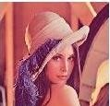
Experimental results
This section contains the experimental results performed on various parameters such as NPCR, Entropy, Correlation, and Histogram analysis. Here MATLAB 2015 version software, a system having Core i3 processor and 2GB RAM i are used for performing proposed work. The following Lenna image is used for performing operations. Figure 4 shows the encrypted and decrypted lenna image..

Slide 12
1. NPCR: The following formulas are used for performing NPCR operation.
The NPCR of the two images is given below
NPCR = ∑ D(i,j) i,j W ×H ∗ 100 %
Where H and W are the height and width of the input image and the value of D(i, j) is calculated as
D(i, j) = { 0, if C1(i, j) = C2(i, j) 1, Otherwise
2. Entropy: It is a statistical measure of randomness that can be used to characterize the texture of the input image. For calculating entropy, the following formula is used –
E (m) = ∑ 𝑝(𝑚𝑗 𝑀−1 𝑗=0 ) log 1 𝑝(𝑚𝑗 )

Slide 13
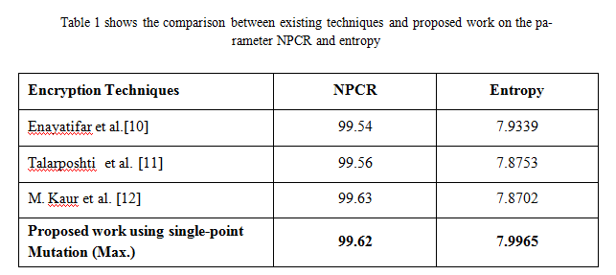

Slide 14
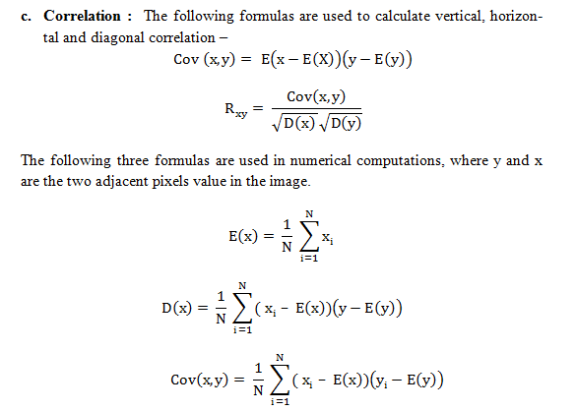

Slide 15
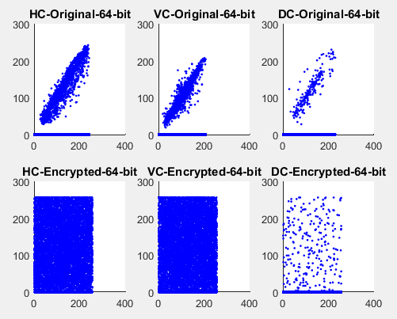
Figure 2 shows the horizontal, vertical and diagonal correlation of original and encrypted Lenna image

Slide 16
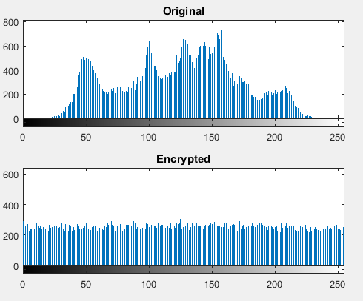
Figure 3 shows the original & encrypted Lenna image histogram

Slide 17
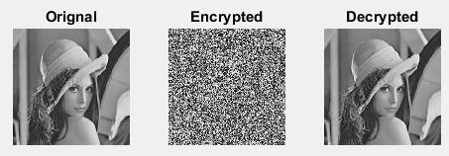
Figure 4 shows the encrypted and decrypted lenna image

Slide 18
Conclusion
Since most of the communications are in the form of images in IoT enabled devices and due to the increasing use of mobile phones, there is a need for a secure image encryption algorithm that is fast and secure in nature.
This work proposed a image encryption technique based on random function, known as mutation operator of genetic algorithm.
For checking the efficiency of the proposed algorithm, experiments are performed on various parameters that show the proposed algorithm is better than the existing techniques described in this paper.

Slide 19
Future Scope
The research work can be extended in the following directions.
To generate pseudorandom bits sequence efficiently which can be further used to control the process of confusion.
To employ more complex chaotic system by which the security of the system can be enhanced.
The above proposed model can be converted into a single hardware chip.

Slide 20
.
Devise certain means that reduce redundancy from the image, which can improve performance of the proposed system.
The proposed research can be used in portable 3G device and secured image “CAPTCHA”.

Slide 21
References
[1] Usman, M., Ahmed, I., Aslam, M., Khan S. and Shah, U., SIT: A Lightweight Encryption Algorithm for Secure Internet of Things. (IJACSA) International Journal of Advanced Computer Science and Applications, Vol. 8, No. 1, 2017.
[2] Stalin, S., Maheshwary, P., Shukla, P., Maheshwari, M., Gour, B. and khare, A., Fast and Secure Medical Image Encryption Based on Non Linear 4D Logistic Map and DNA Sequences (NL4DLM_DNA). Journal of medical system(Springer), July 2019.
[3] Zhang, X., Zhou, H., Zhou, Z., Wang, L. and Li, C., An Image Encryption Algorithm Based on Hyper-chaotic System and Genetic Algorithm. Qiao J. et al. (eds) Bio-inspired Computing: Theories and Applications. BIC-TA 2018. Communications in Computer and Information Science, Vol 952. Springer, Singapore.

Slide 22
[4] Guesmi, R., Farah, M., Kachouri, A. and Samet, M., Hash key-based image encryption using Mutation operator and chaos. Multimedia Tools and Applications April 2016, Volume 75, Issue 8, pp 4753–4769
[5] Samhita, P., Prasad, P., Patro, K. and Acharya, B., A Secure Chaos-based Image Encryption and Decryption Using Mutation and Mutation Operator. I J C T A, 9(34) 2016, pp. 17-28
[6] Huang, X., Sun, T., Li, Y., and Liang, J., A color image encryption algorithm based on a fractional-order Hyperchaotic system. Entropy, MDPI 17:28–38, 2015.
[7] Tong, X., Yang, L., Zhang, M., Xu, H., and Zhu, W., An image encryption scheme based on Hyperchaotic Ra, binovich and exponential Chaos maps. Entropy,MDPI 17:181–196, 2015
[8] Tian, Y., and Lu, Z., Novel permutation-diffusion image encryption algorithm with chaotic dynamic S-box and DNA sequence operation. AIP Advances:1–23, 2017.

Slide 23
[9] Ye, G., Jiao, K., Pan, C., and Huang, X., An effective framework for chaotic image encryption based on 3D logistic map. Hindawi Security and Communication Networks:1–11, 2018
[10]Enayatifar, R., Abdullah, A. H. & Lee, M. [2013] “A weighted discrete imperialist competitive algorithm (WDICA) combined with chaotic map for image encryption,” Opt. Lasers Eng. 51, 1066–1077
[11] Enayatifar, R., Abdullah, A. H. & Isnin, I. F. [2014] “Chaos-based image encryption using a hybrid genetic algorithm and a DNA sequence,” Opt. Lasers Engin. 56, 83–93.
[12] Talarposhti, K. M. & Jamei, M. K. [2016] “A secure image encryption method based on dynamic harmony search (DHS) combined with chaotic map,”Opt. Lasers Engin. 81, 21–34.
[13] Liu B, Li Y, Zeng B, Lei C. An efficient trust negotiation strategy towards the resource-limited mobile commerce environment. Frontiers of Computer Science, 2016, 10(3): 543–558

Slide 24
Publications
Rajput, R., Gupta, M. Mutation Operator based Image Encryption Algorithm for Securing IoT. International conference on Machine Intelligence & Smart System (MISS- 2020), Springer Conference.
Rajput, R., Gupta, M. & Sharma, P. A Robust Image Cryptographic Techniques: A Survey. Artificial & Computational Intelligence, Vol 1, Issue 5, March 2020.

Slide 25
THANK YOU

